Slide 1
Sequence Alignment & Similarity
Md Mazedul Haq

Slide 2
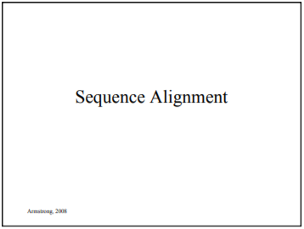
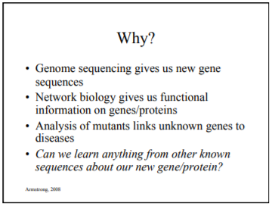
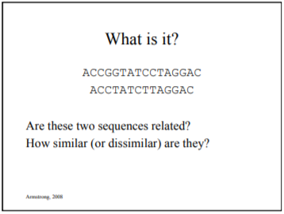
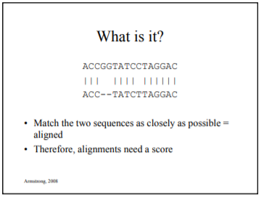
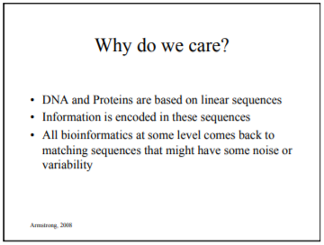

Slide 3
Different Types of DATA
Transcriptome: entire collection of all RNA transcripts in a cell/tissue at a given time point.
Proteome: entire collection of all proteins in a cell/tissue at a given time point.
miRNome: entire collection of all microRNAs (miRNAs) in a cell/tissue at a given time point.
Interactome: the collection of all possible molecular interactions (or a subset of molecular interactions) in a cell

Slide 4
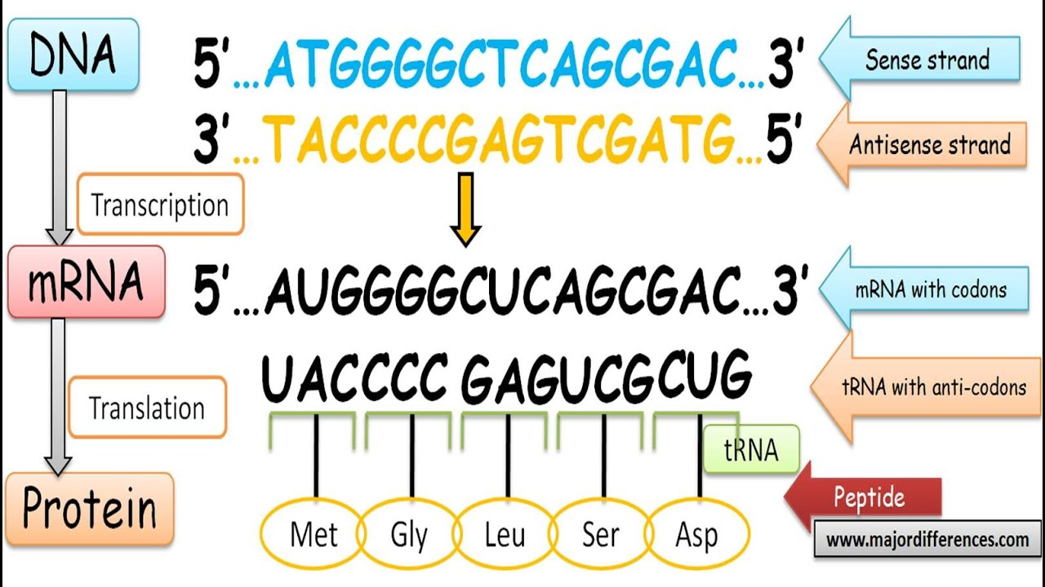
DATA Format
Sense/coding/(+) strand
FASTA
Always starts with “>” sign in the description line
“>” is followed by a definition or Identifier of the sequence.
There should be no space between “>” and the first letter of the identifier.
The sequence can be written with or without gaps from the second paragraph.
For mRNA sequence data “T” is used instead of “U” as sequence uses the sense strand of complementary DNA (cDNA).
Antisense/noncoding/(-) strand/template strand

Slide 5
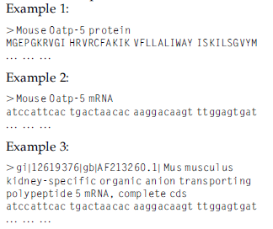
Identifier
Identifier with multiple lines

Slide 6
PHYLIP Format
Phylogeny Inference Package
Data types that can be handled include DNA and protein sequences, gene frequencies, restriction sites, distance matrices.
The first line of the input file shows the number of species and the number of characters separated by a space only.
The information for each species starts with a 10-character species name.
If the species name is not 10 characters long, then a space is introduced to make it 10-character equivalent.
H. sapiens has a space before “sapiens,” but other species names do not have any such space.
DNA and protein sequence may start
immediately after the species name

Slide 7
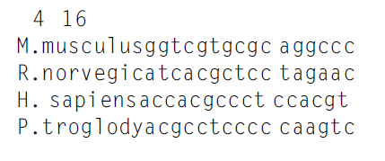
PHYLIP Example
number of species and characters
Characters
10 character species name
Space given to make the 10 characters

Slide 8
Sequence Flatfile
Contains the name of the mRNA/gene, the source, annotation, open reading frame, and putative translation product.
Sometimes contain information about the total number of “A,” “C,” “G,” and “T” in the sequence.
GenBank: http://www.ncbi.nlm.nih.gov/Sitemap/samplerecord.html
DDBJ: http://www.ddbj.nig.ac.jp/sub/ref10-e.html
EMBl-Bank: ftp://ftp.ebi.ac.uk/pub/databases/embl/release/usrman.txt (EMBL-Bank User Manual)

Slide 9
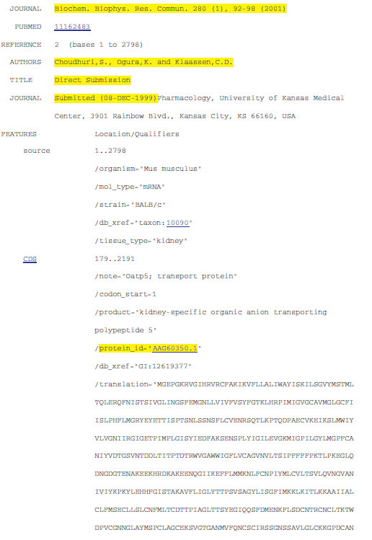
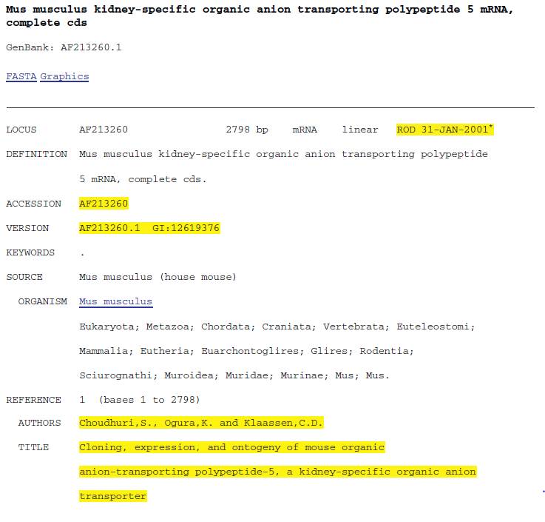
Flatfile Example

Slide 10
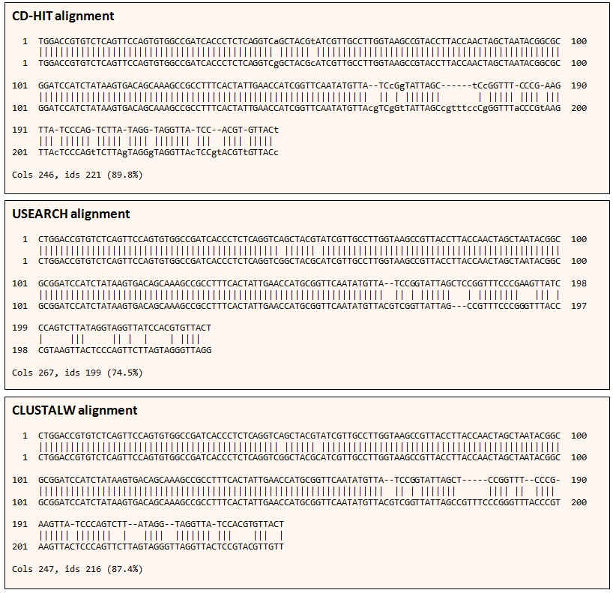

Sequence Identity
Sequence identity means the same residues being present at corresponding positions in two sequences being compared. For proteins, it means the same amino acids; for nucleic acids, it means the same bases.

Slide 11
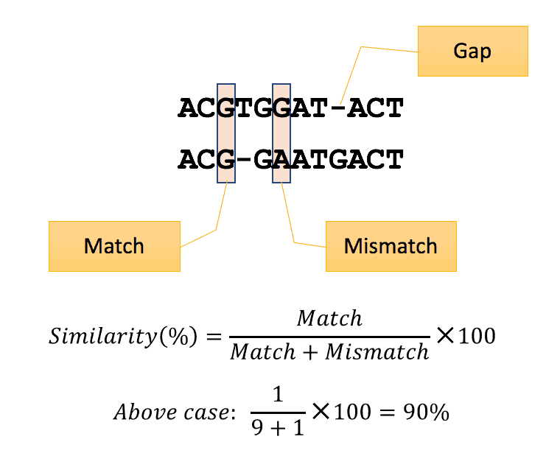

Sequence Similarity
Sequence similarity means similar residues being present at corresponding positions in the two sequences being compared.
For nucleic acids, sequence similarity and sequence identity are the same.
For proteins, sequence similarity involves amino acids with similar physicochemical and functional properties.

Slide 12
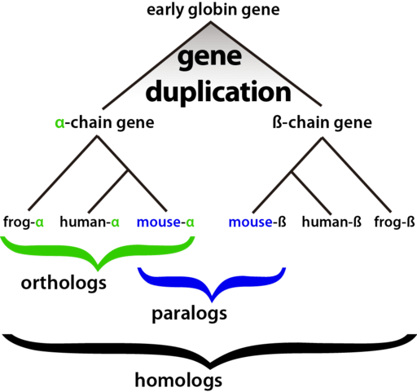
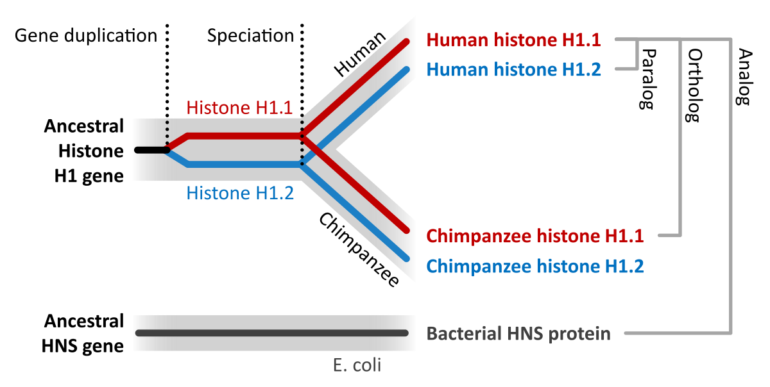
Homologous Sequence
Sequences are called homologous if they have a common evolutionary origin.
sequences are either homologous or not homologous and there is no quantitation of homology.

Slide 13
Local Sequence Alignment
local sequence alignment is intended to find the most similar regions two sequences being aligned.
The algorithm that drives local alignment is the Smith Waterman algorithm.
A local alignment algorithm finds the region of highest similarity between two sequences and builds the alignment outward from this region.
If there are multiple regions of very high similarity, the same principle applies.

Slide 14
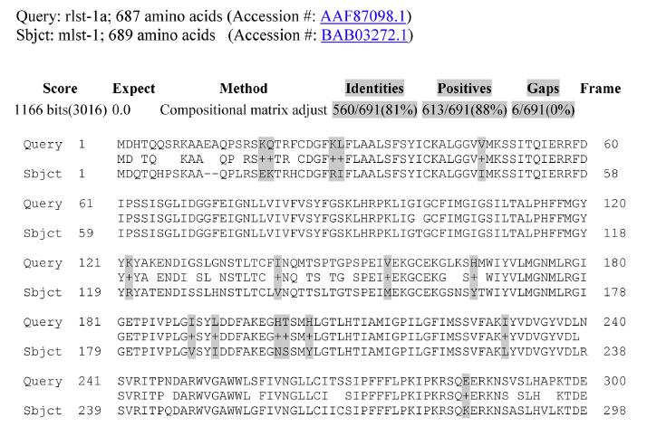
Pairwise alignment of rlst-1a and mlst-1 proteins using NCBI BLAST. NCBI BLAST pairwise alignment shows that these two proteins share 81% identity but 88.7% similarity. The similar amino acids are highlighted in gray; many of these are hydrophobic amino acids, charged polar amino acids, and neutral polar amino acids. In the NCBI BLAST pairwise alignment format, the identical amino acids and similar substitutions between the query and the subject sequences are in the middle; and similar substitutions are indicated by a +sign.

Slide 15
Global Alignment
Aligns and compares two sequences along their entire length, and comes up with the best alignment that displays the maximum number of nucleotides or amino acids aligned.
The algorithm that drives global alignment is the Needleman Wunsch algorithm.
A global alignment algorithm starts at the beginning of two sequences and adds gaps to each until the end of one is reached.
Global alignment works the best when the sequences are similar in and length.

Slide 16
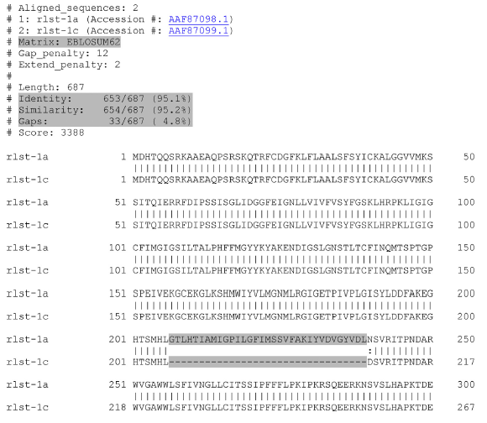
Pairwise global alignment of rlst-1a and rlst-1c proteins using EMBL-EBI EMBOSS. EMBOSS Needle (Needleman Wunsch algorithm) shows that the rlst-1c protein is an alternatively spliced form missing a 33-amino-acid segment that is present in the rlst-1a protein (highlighted).

Slide 17
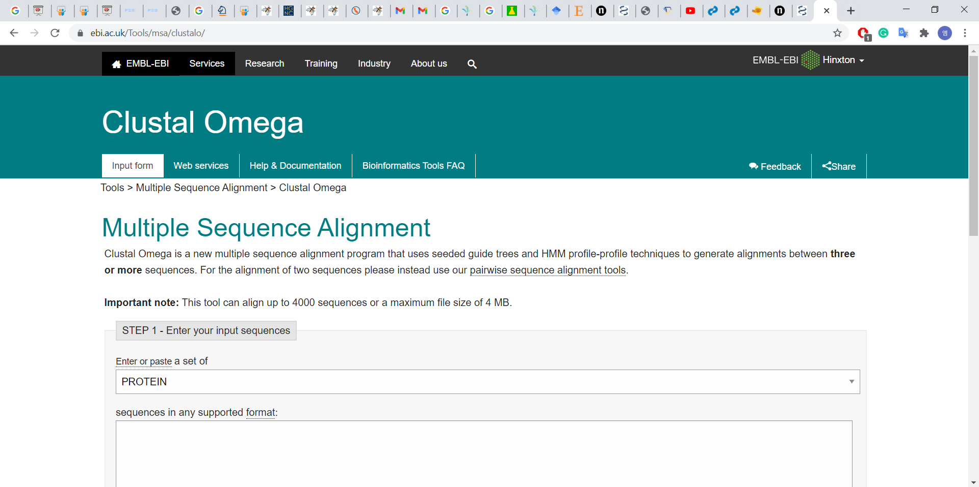
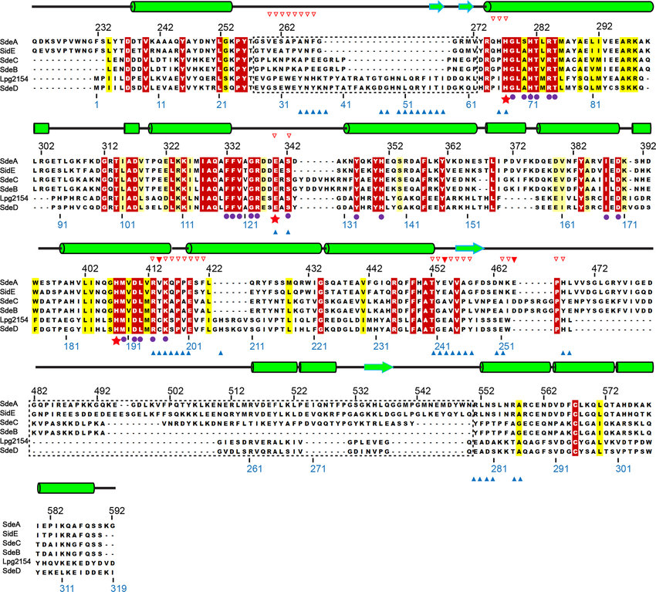
Multiple Alignment
Multiple alignment performs the same function using more than two sequences.
The purpose of alignment is to identify regions of similarity that may have structural, functional, and evolutionary consequences.

Slide 18
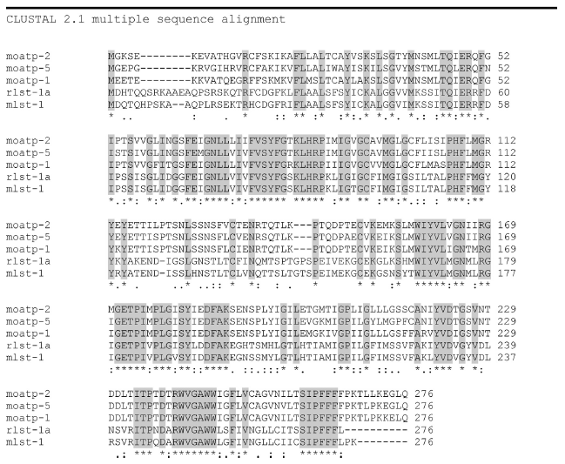
Multiple alignment using ClustalW. Five transporters from rat and mouse have been aligned. Identical amino acids are indicated by a star (*), whereas (strong) similar substitutions are indicated by a colon (:). A dot refers to a mismatched aa with (weak) similar biochemical property.

Slide 19
THANK YOU

